Slide 1
EN.520.612 MLSP Project Cervical Spine Fracture Detection with Deep Learning
Team Members: Ruxiao Duan
Qihua Gong
Weichen Qi
Tingying Lu
Yifan Zhou

Slide 2
Contents
1. Introduction
2. Dataset
3. Methodology
4. Experiments
5. Discussion
6. Visualization

Slide 3

1. Introduction

Slide 4
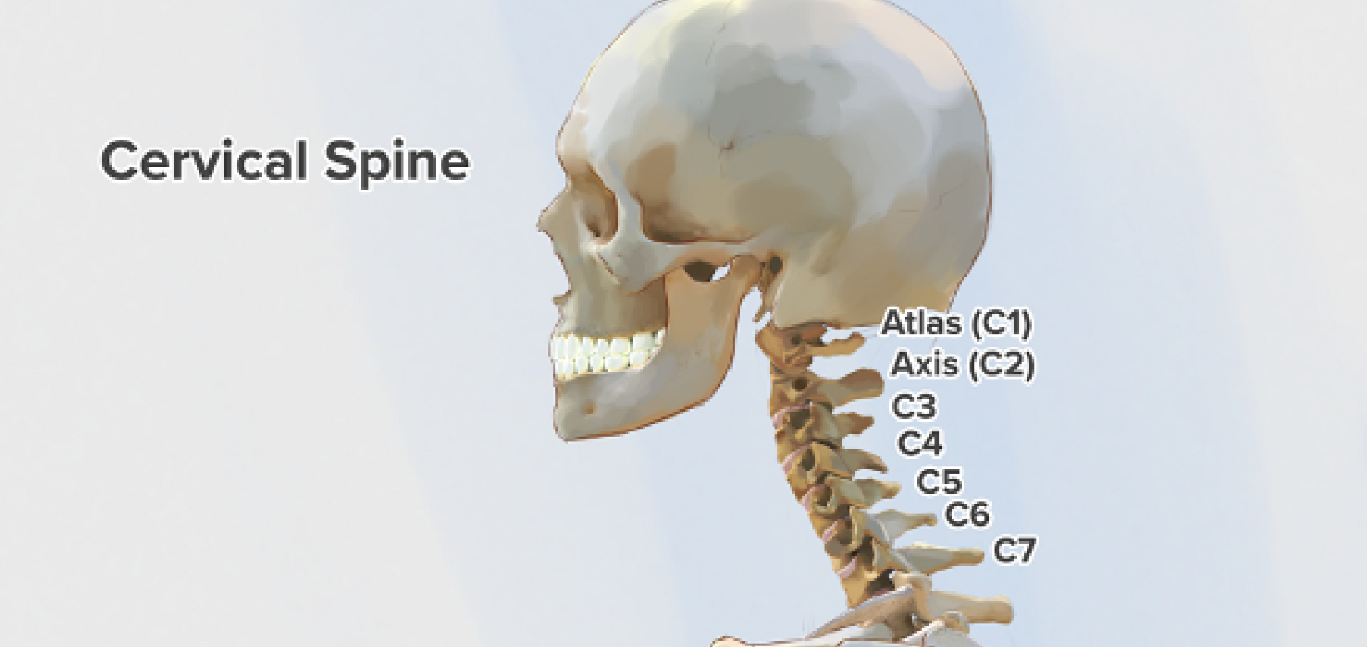
1.1. Background
Seven vertebrae of a human cervical spine

Slide 5
1.2. Objectives
Main task:
Identify fractures on human cervical spine with deep convolutional neural networks
on the vertebra-level (C1-C7)
Minor tasks:
Detect the exact fracture position on a slice
Extract the identified fractures and perform 3D visualization
on the slice-level
on the patient-level

Slide 6
1.3. Applications
Early detection of cervical spine fractures
Auto-diagnosis of relevant diseases
Auto-extraction and visualization of cervical spine fractures

Slide 7
2. DaTASET

Slide 8
2. Dataset
Computed tomography (CT) scans collected from 12 sites globally by
Radiological Society of North America (RSNA)
American Society of Neuroradiology (ASNR)
American Society of Spine Radiology (ASSR)
2,019 CT studies (patients) available for use
200-600 slices per patient
711,601 CT images in total

Slide 9
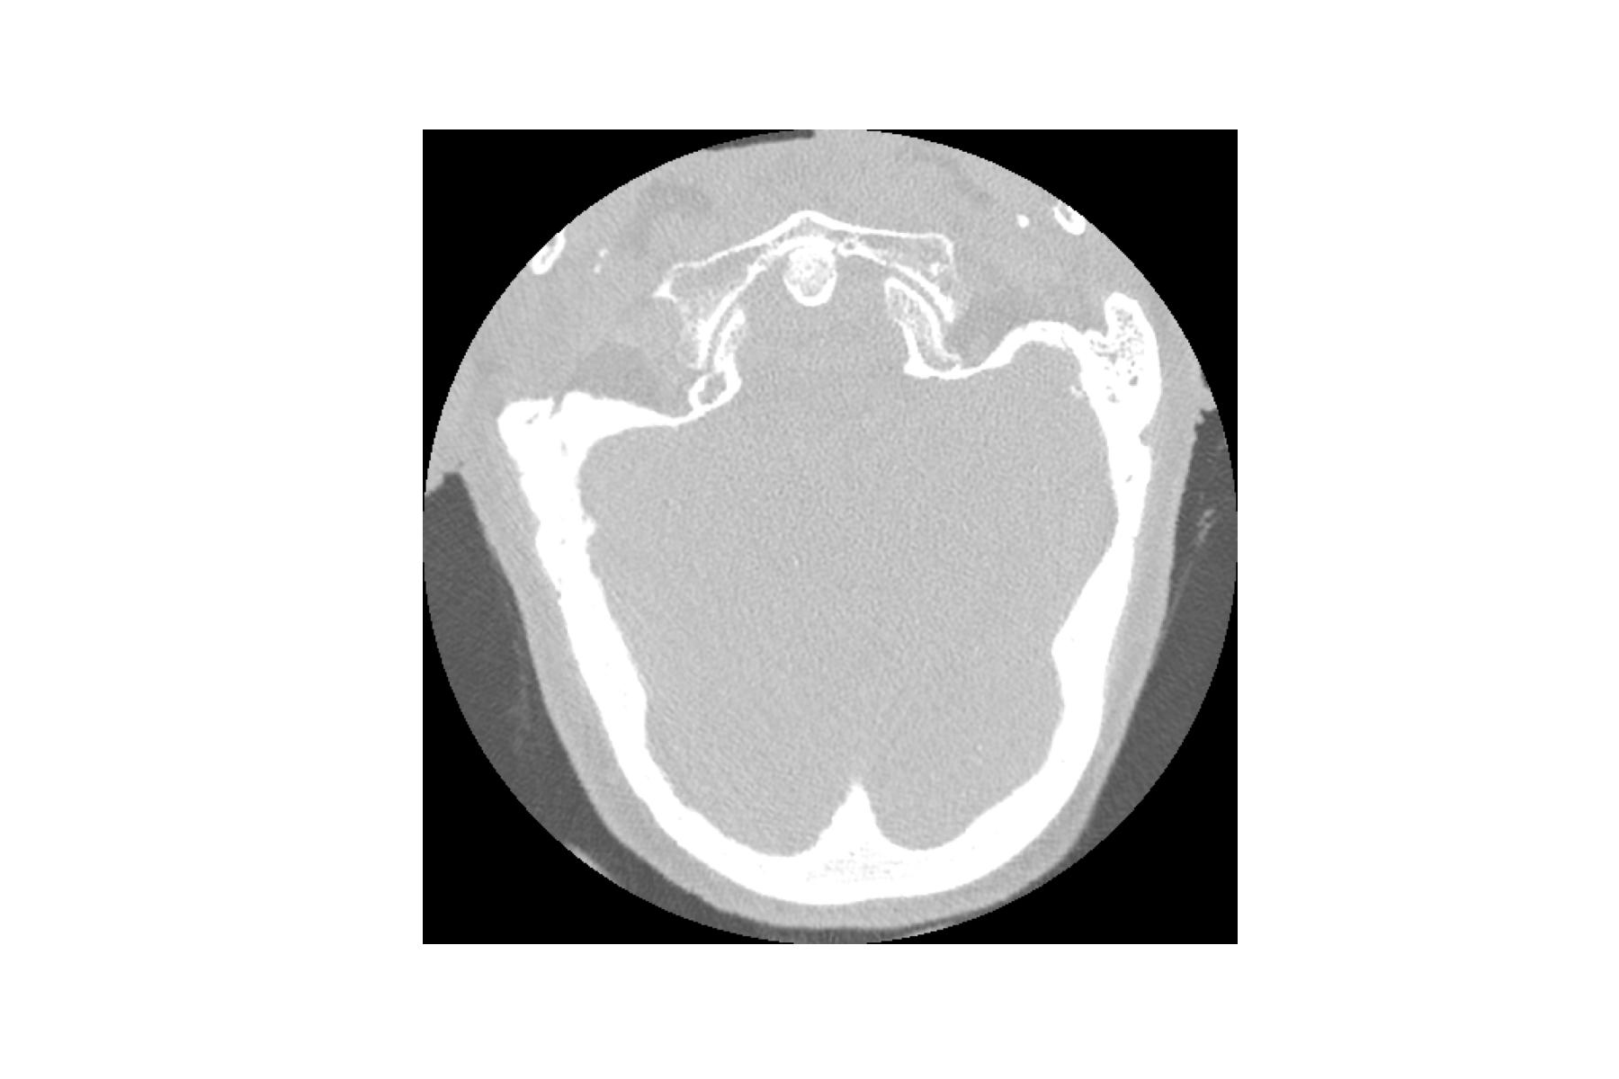
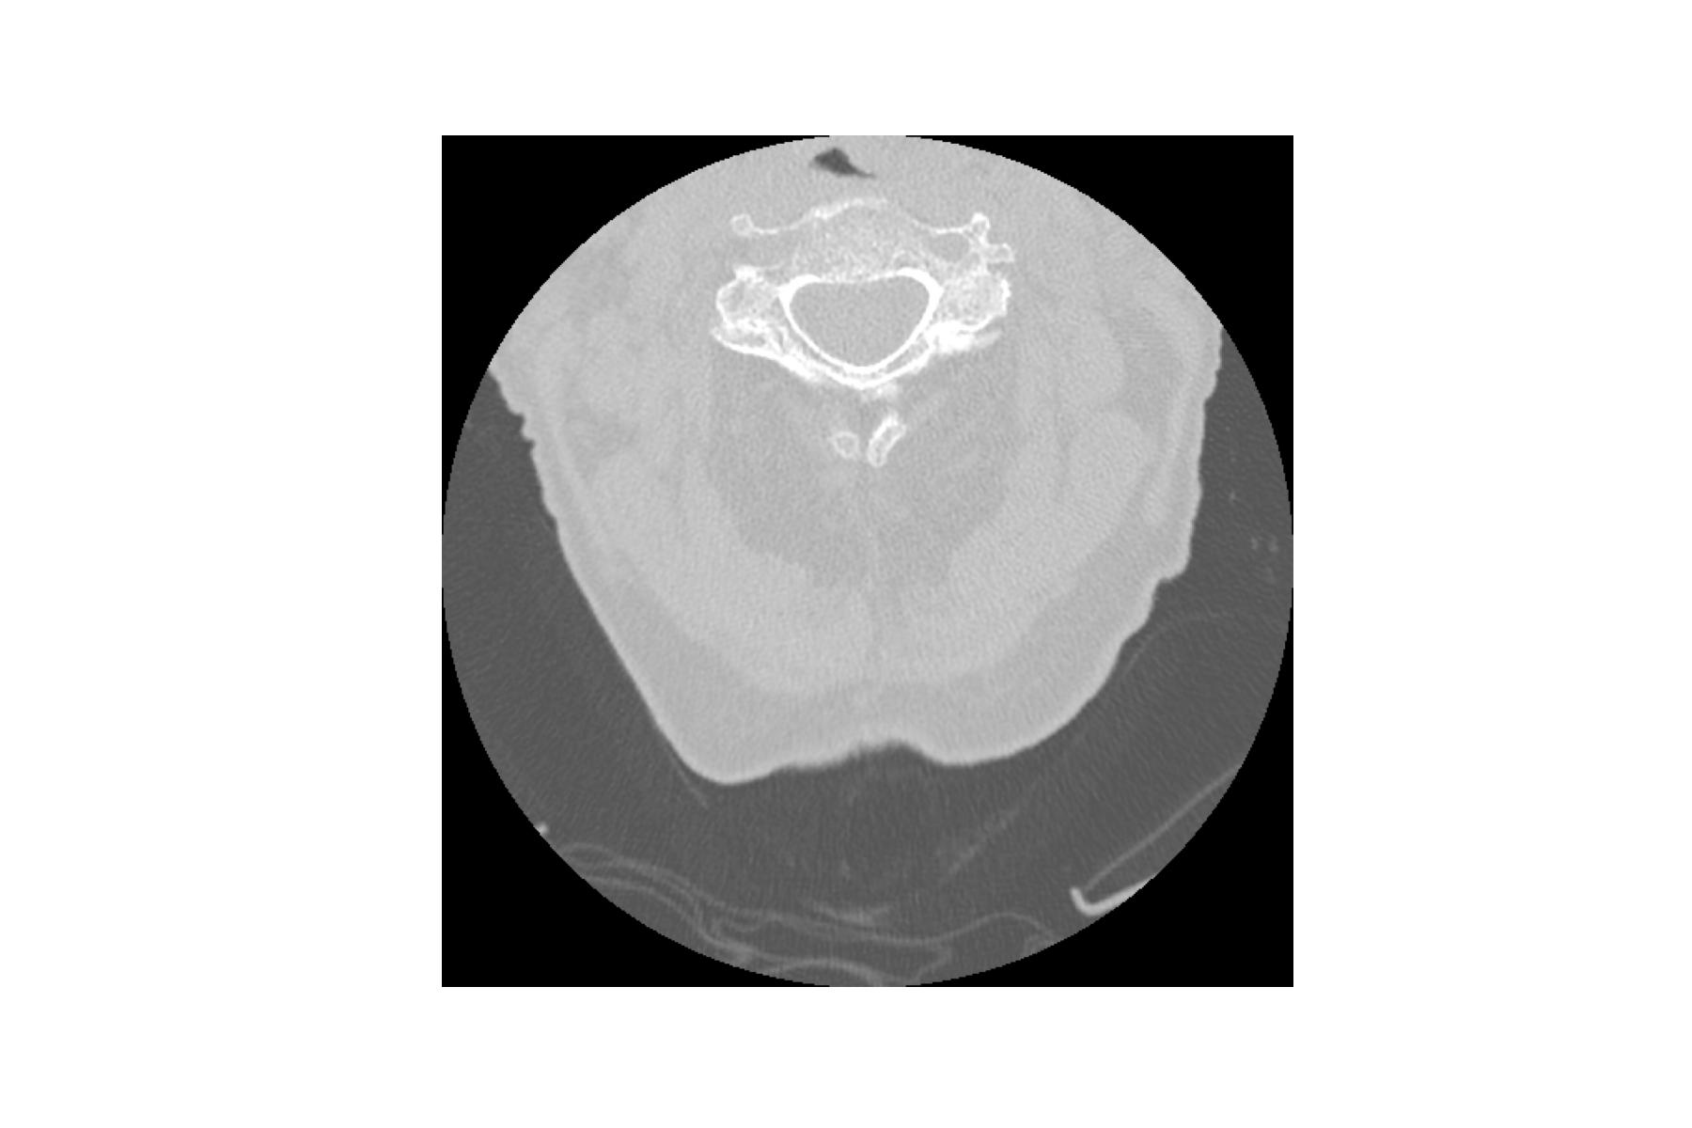
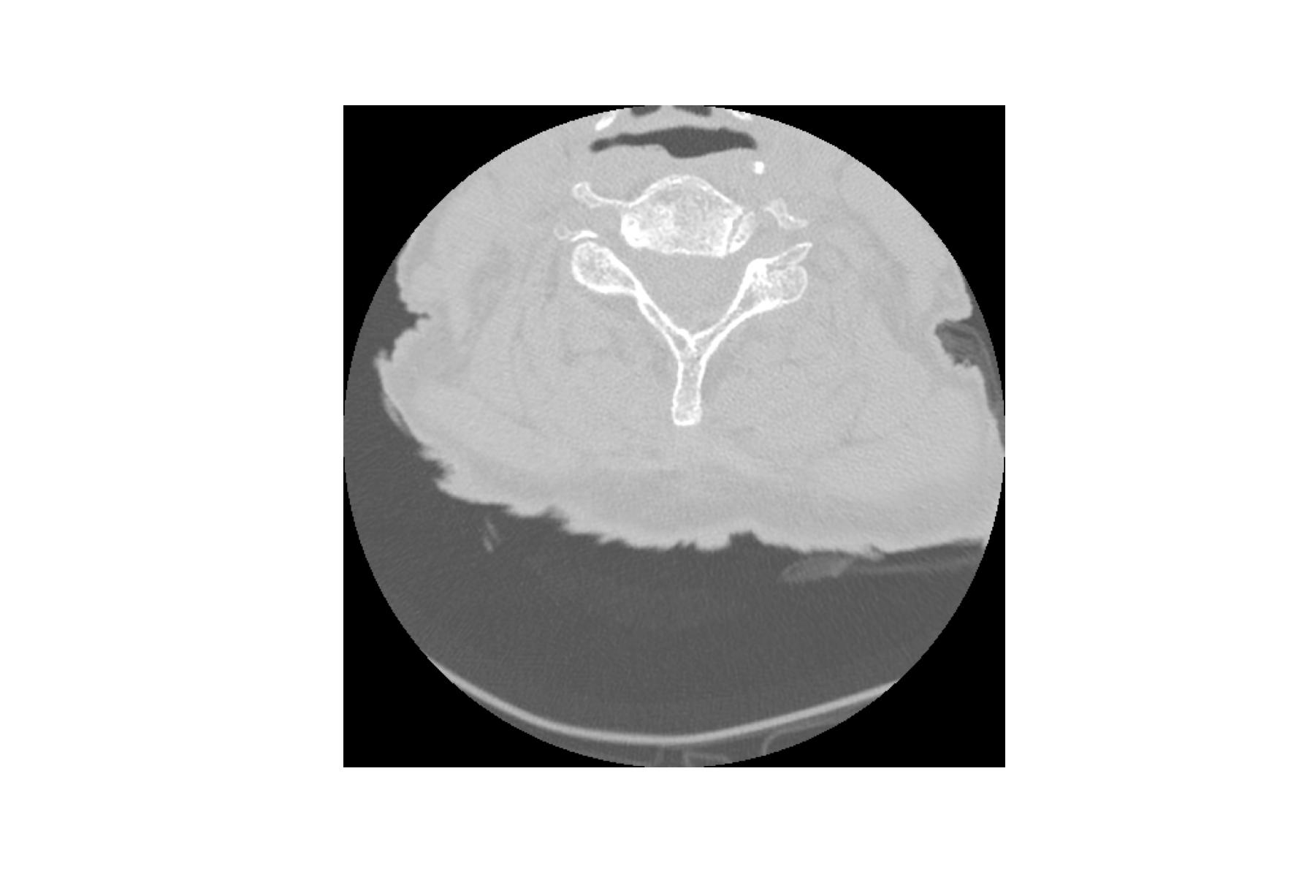
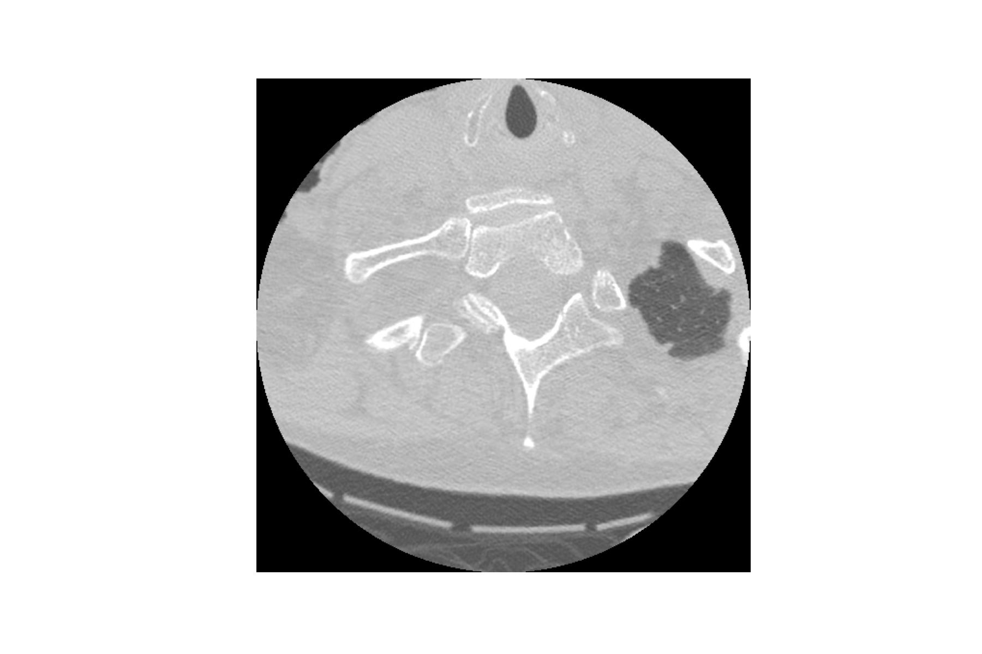
2.1. CT Images (2,019 Patients)
CT scans:
Patient id: 17625
Slice 50
Slice 100
Slice 150
Slice 200
Image metadata:
Image position (x, y, z coordinates)
Slice thickness

Slide 10
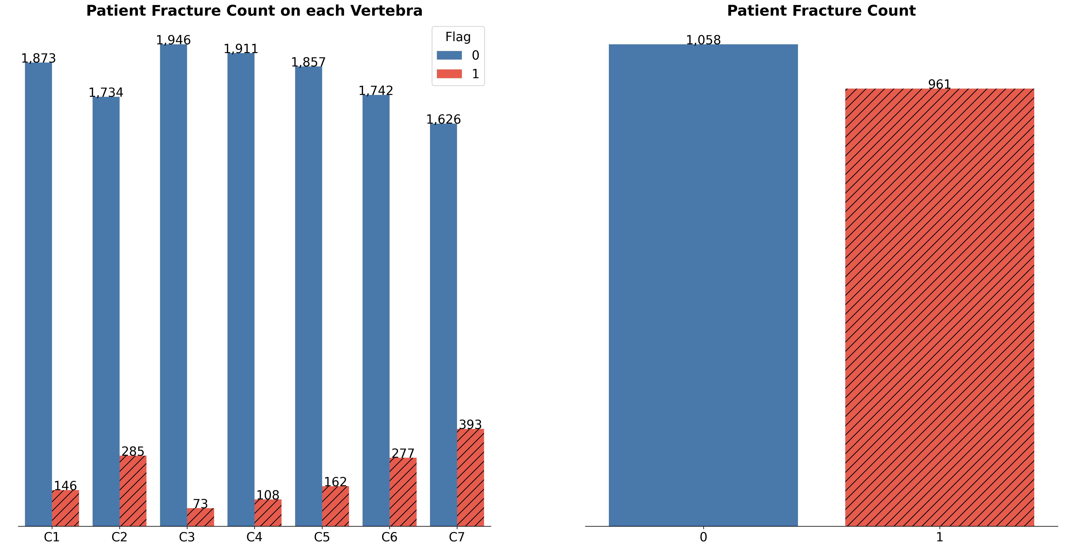
2.2. Fracture Labels (2,019 Patients)

Slide 11
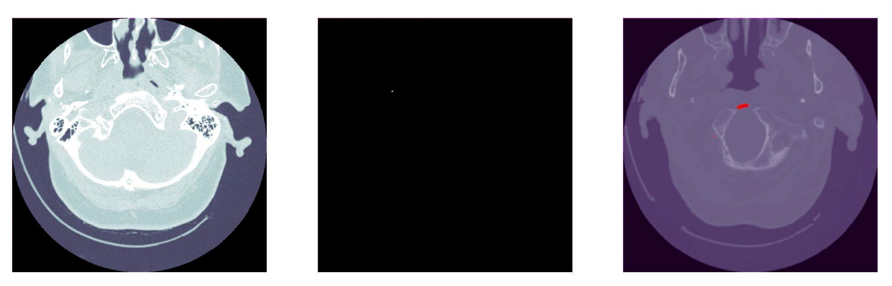
2.3. Pixel-level Vertebrae Labels (87 Patients)
C1
C2
C3
C4
C5
C6
C7

Slide 12
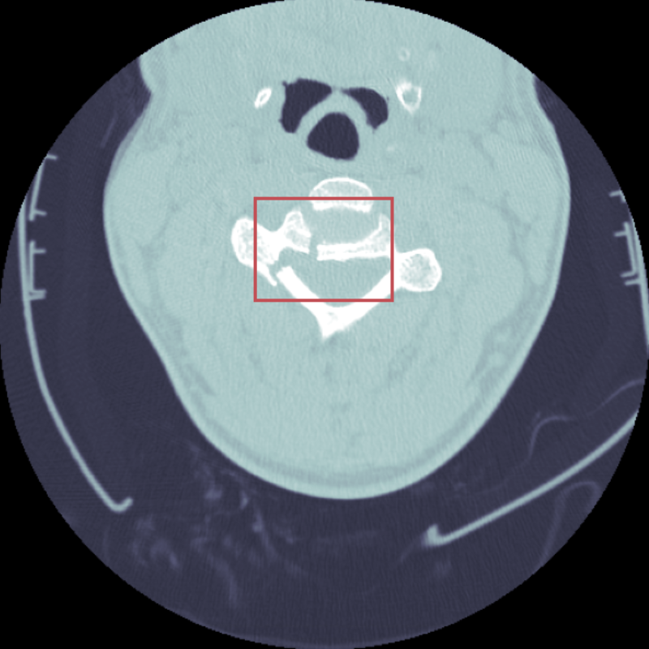
2.4. Fracture Locations (239 Patients)

Slide 13
3. METHODOLOGY

Slide 14
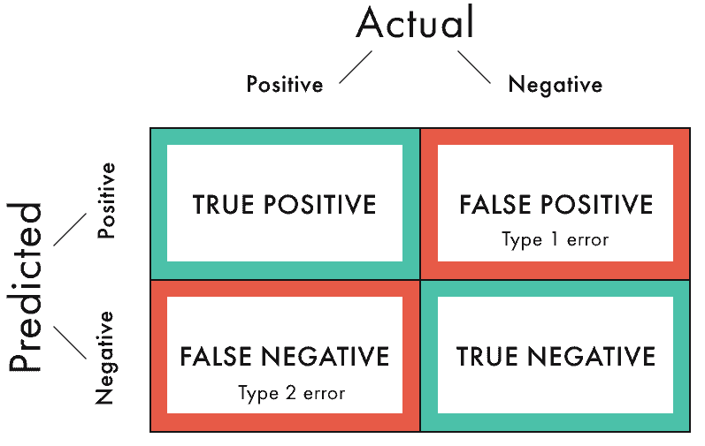
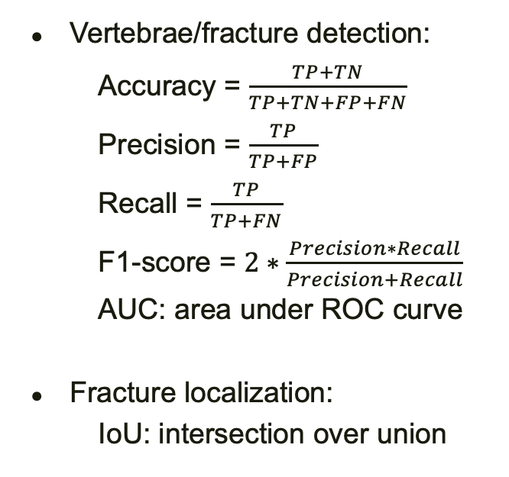
3.1. Evaluation Metrics
Vertebrae/fracture detection:
Accuracy = $\frac{TP+TN}{TP+TN+FP+FN}$
Precision = $\frac{TP}{TP+FP}$
Recall = $\frac{TP}{TP+FN}$
F1-score = $2∗\frac{Precision∗Recall}{Precision+Recall}$
AUC: area under ROC curve
Fracture localization:
IoU: intersection over union
Confusion Matrix

Slide 15
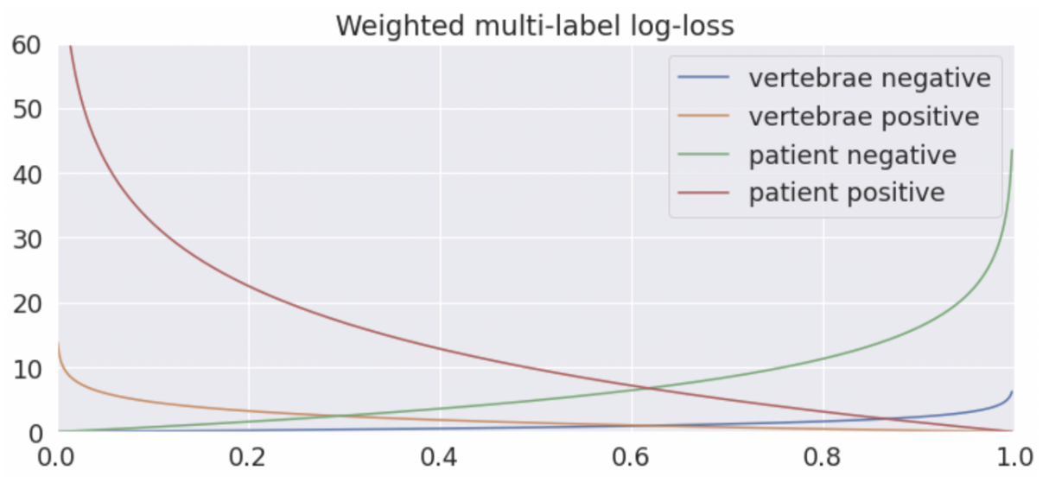
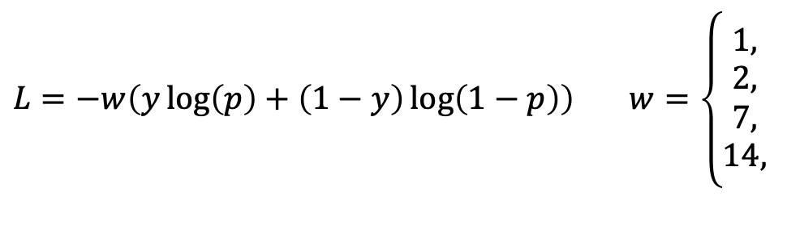

3.2. Loss Function
$L=−w\left(y\log\left(p\right)+\left(1−y\right)\log\left(1−p\right)\right)$ $w=\left\{\begin{aligned}1, \\ \begin{matrix}2, \\ 7,\end{matrix} \\ 14,\end{aligned}\right.$
Weighted binary cross-entropy
if vertebra negative
if vertebra positive
if patient negative
if patient positive

Slide 16
3.3. Project Pipeline
Image Preprocessing
Vertebrae Detection
Fracture Detection
Fracture Localization

Slide 17
3.3.1. Image Preprocessing
Resizing: resolution 512×512
Rescaling: pixel value 0-255
Data augmentation:
random rotation
random horizontal flip
random brightness, contrast, saturation and hue
Noise reduction:
background detection by thresholding
image segmentation by K-means clustering

Slide 18
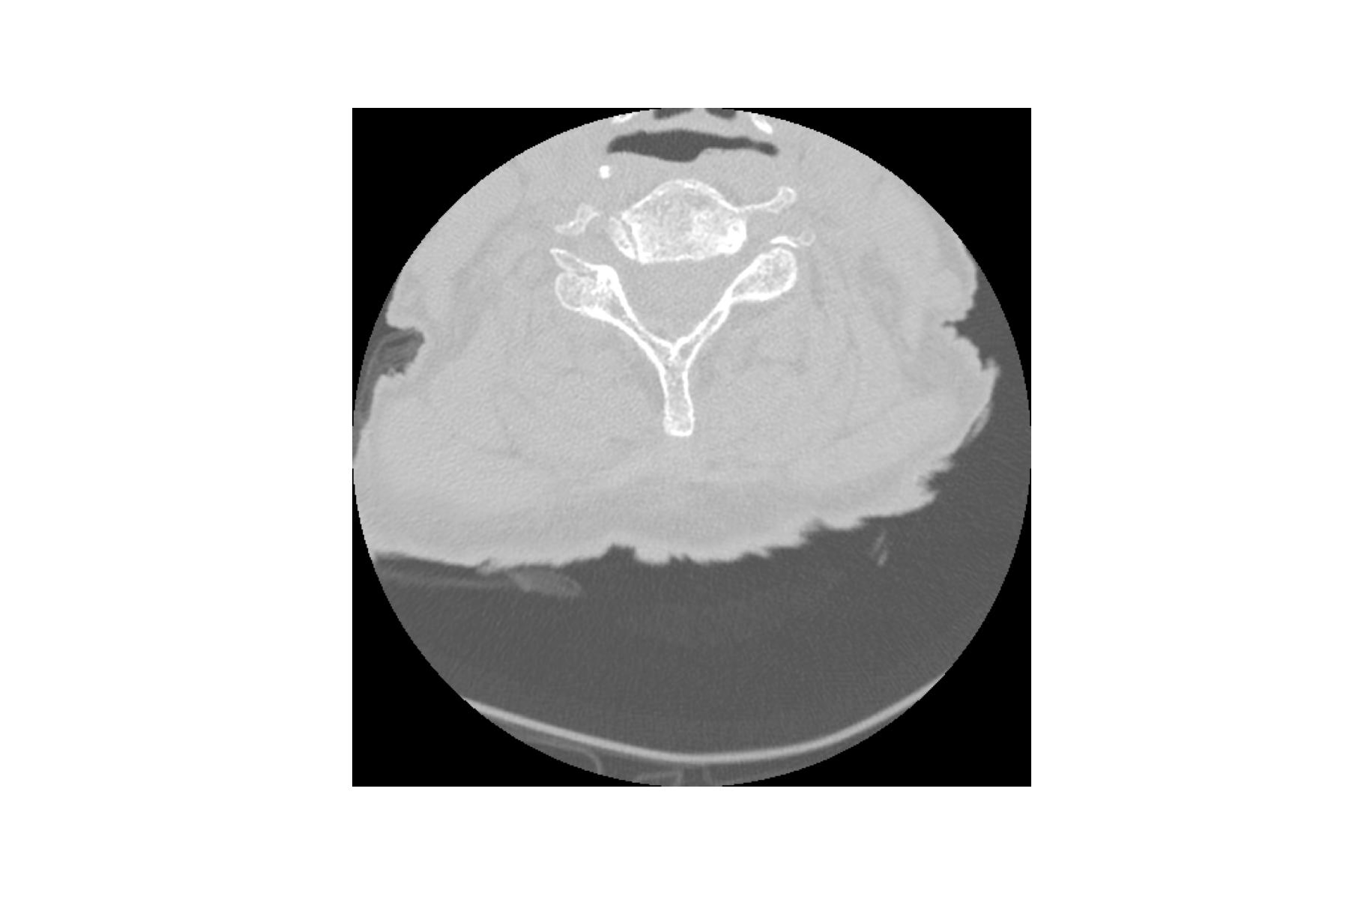
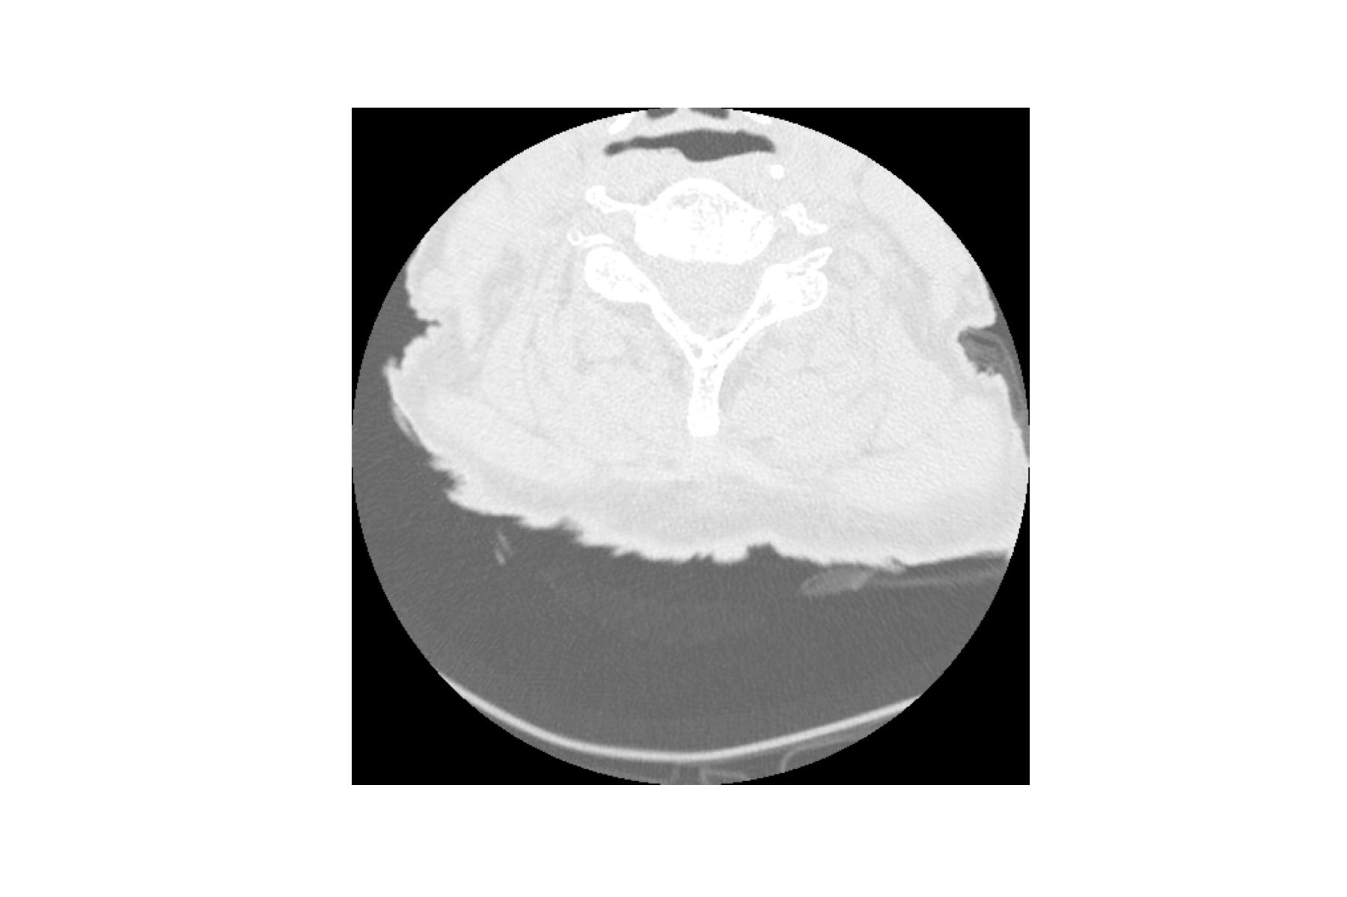

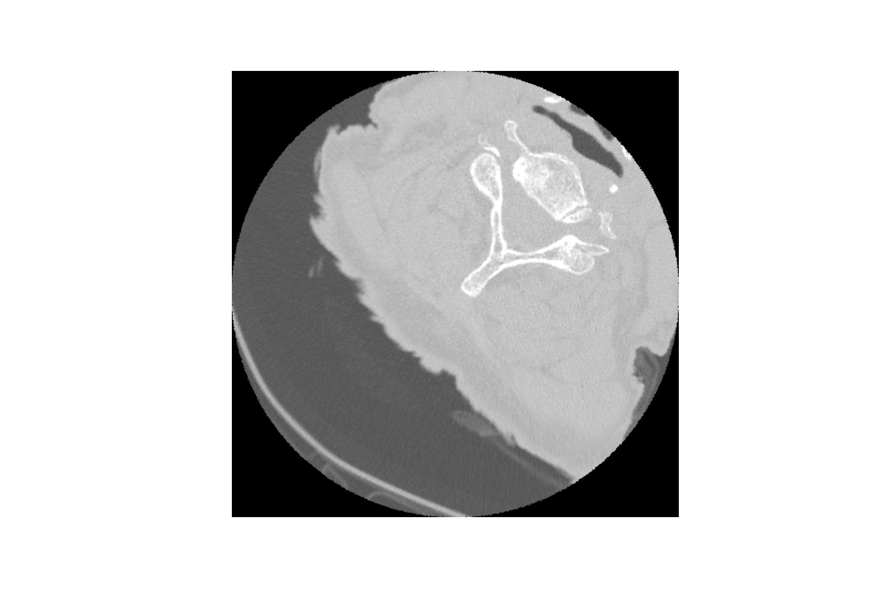

3.3.1. Image Preprocessing: Data Augmentation
Horizontal Flip
Brightness
Saturation
Original Image
Rotation
Contrast
Hue

Slide 19
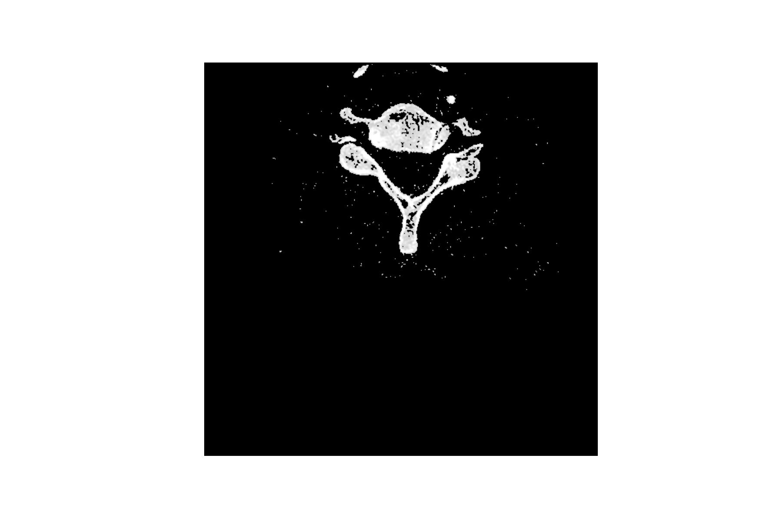
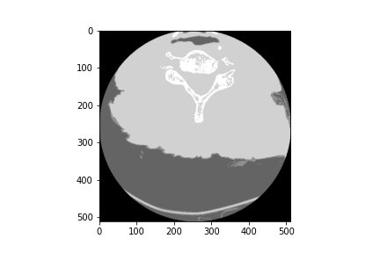
3.3.1. Image Preprocessing: Noise Reduction
Original Image
Thresholding
K-Means Segmentation

Slide 20
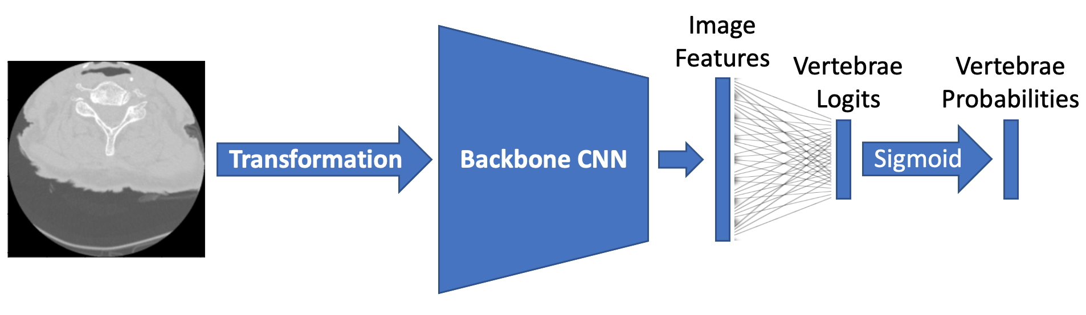
3.3.2. Vertebrae Detection: Type 1 Model
Image input only

Slide 21
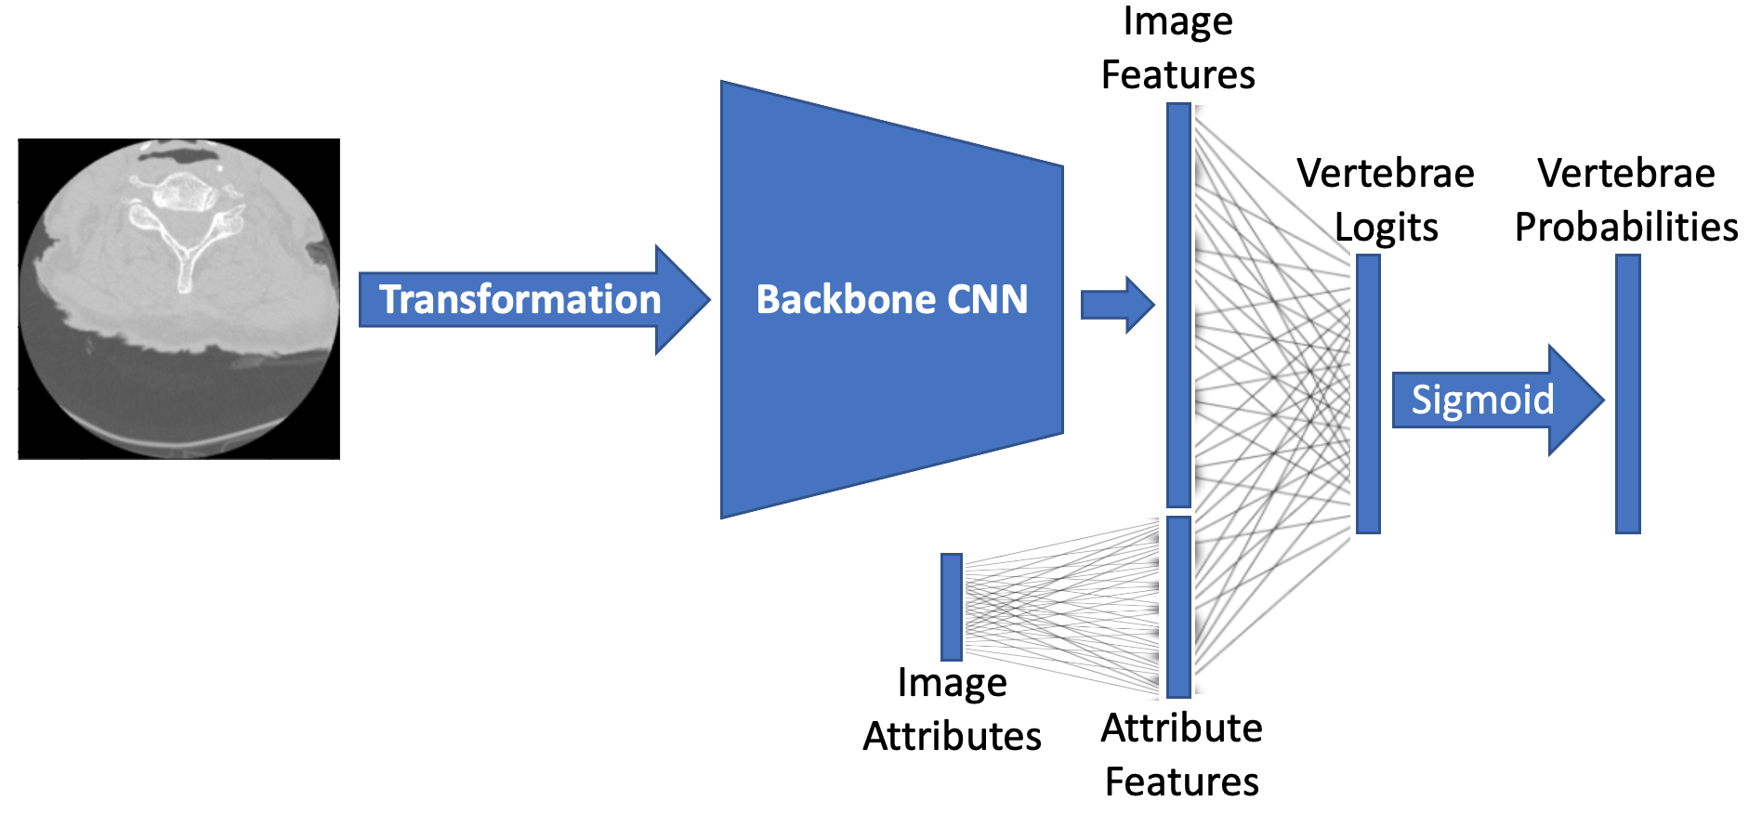
3.3.2. Vertebrae Detection: Type 2 Model
Image and metadata inputs [multimodal learning]
Auxiliary attributes:
image position 3D coordinates
slice thickness
slice ratio

Slide 22
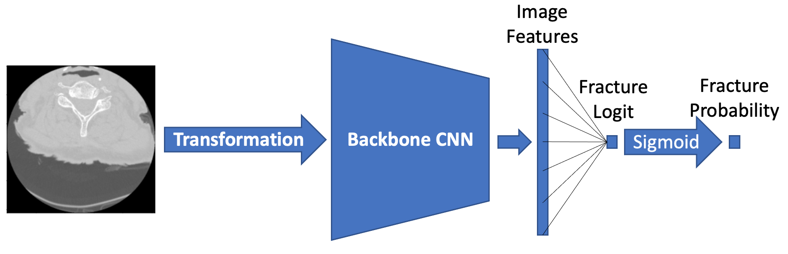
3.3.3. Fracture Detection: Type 1 Model
Single probability output

Slide 23
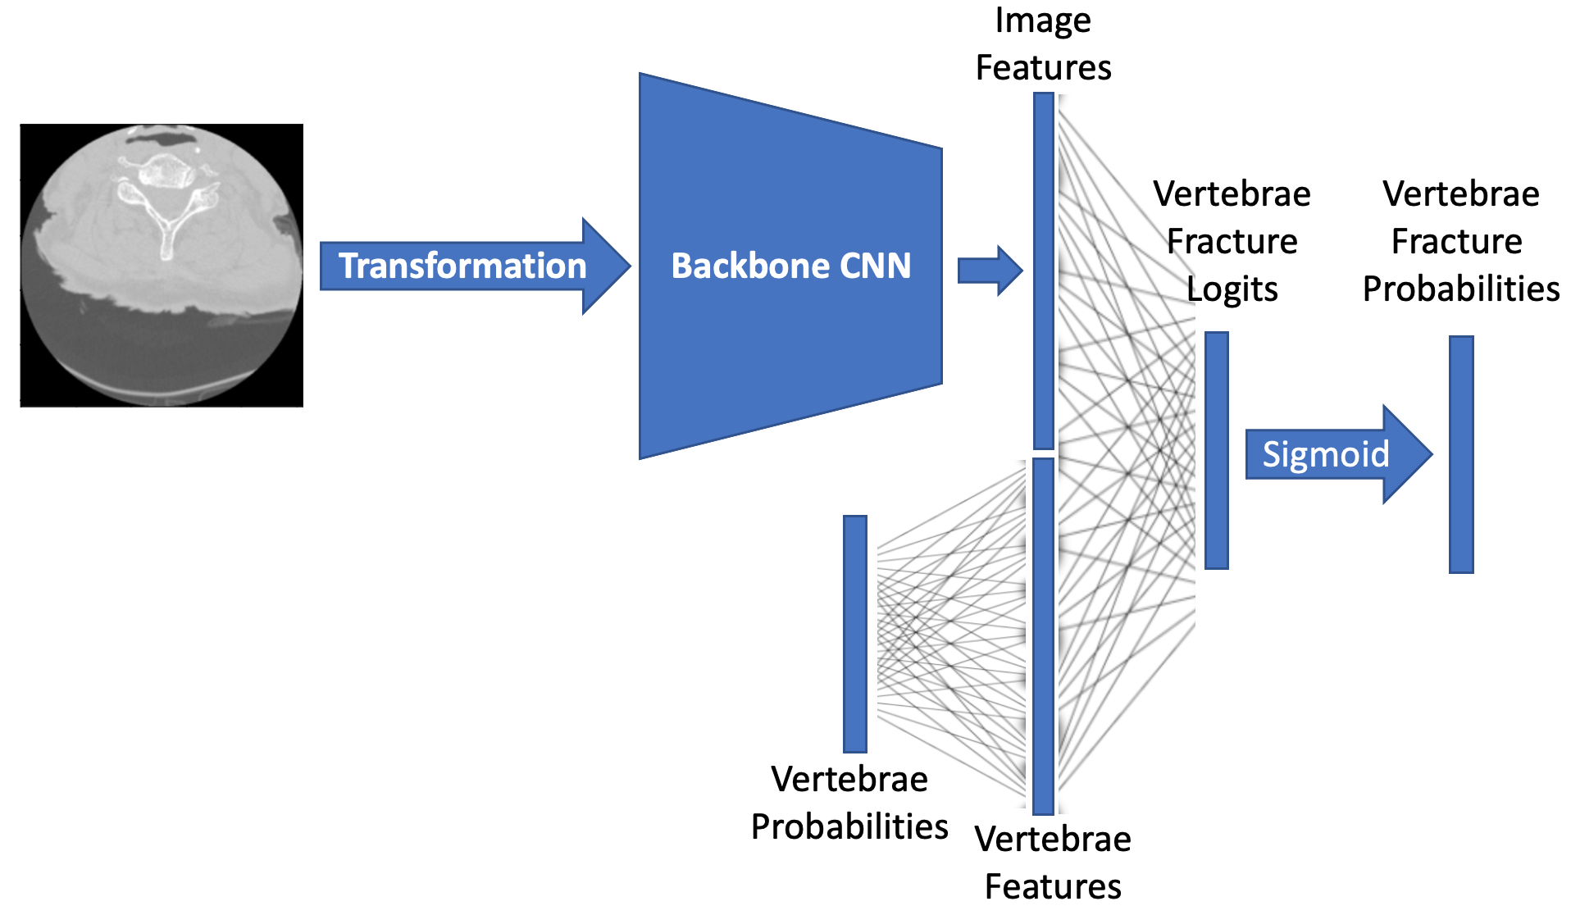
3.3.3. Fracture Detection: Type 2 Model
Vertebrae probabilities input [multimodal learning]

Slide 24
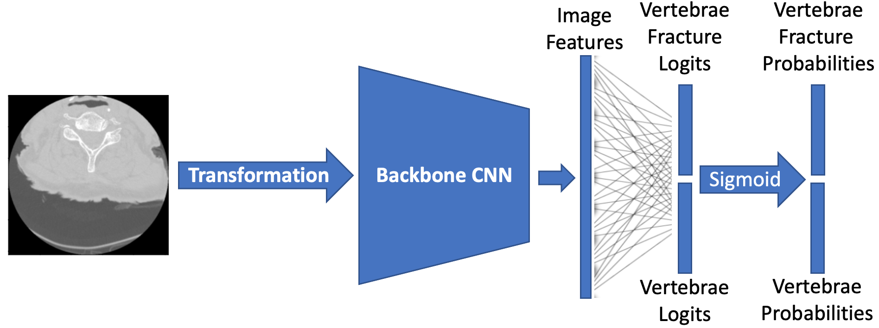
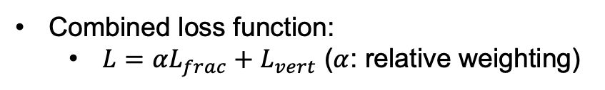
3.3.3. Fracture Detection: Type 3 Model
Vertebrae probabilities output [multi-task learning]
Combined loss function:
$L=αL_{frac}+$ $L_{vert}$ ($α$: relative weighting)

Slide 25
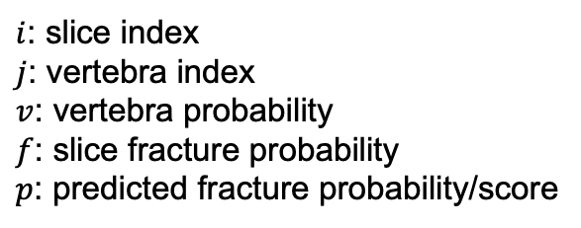
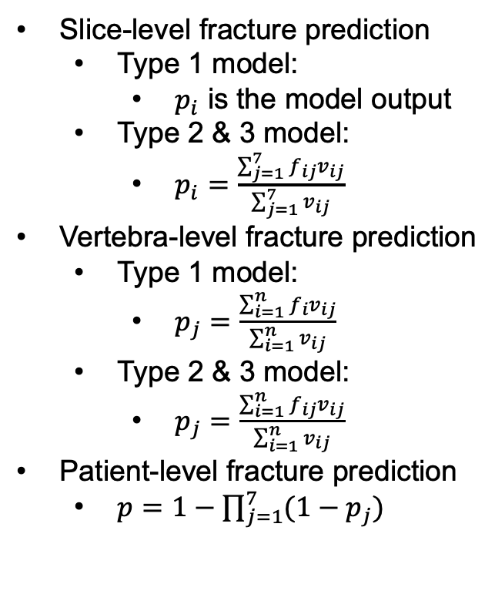
3.3.3. Fracture Prediction
Slice-level fracture prediction
Type 1 model:
$p_{i}$ is the model output
Type 2 & 3 model:
$p_{i}=\frac{\sum_{j=1}^{7}{f_{ij}v_{ij}}}{\sum_{j=1}^{7}{v_{ij}}}$
Vertebra-level fracture prediction
Type 1 model:
$p_{j}=\frac{\sum_{i=1}^{n}{f_{i}v_{ij}}}{\sum_{i=1}^{n}{v_{ij}}}$
Type 2 & 3 model:
$p_{j}=\frac{\sum_{i=1}^{n}{f_{ij}v_{ij}}}{\sum_{i=1}^{n}{v_{ij}}}$
Patient-level fracture prediction
$p=1−\prod_{j=1}^{7}{(1−p_{j})}$
$i$: slice index
$j$: vertebra index
$v$: vertebra probability
$f$: slice fracture probability
$p$: predicted fracture probability/score

Slide 26
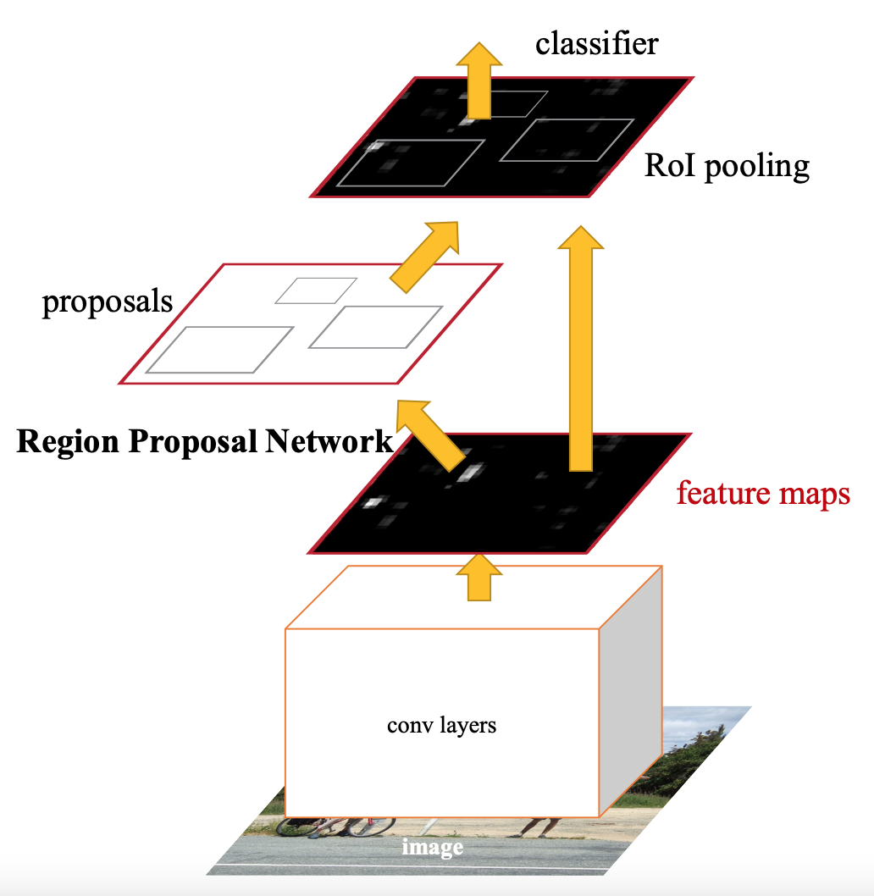
3.3.4. Fracture Localization
Faster R-CNN

Slide 27
4. EXPERIMENTS

Slide 28
4.1. Data Preprocessing
Data augmentation:
Negligible improvement
Not that beneficial in single-epoch training
Noise reduction:
Ineffective
Model performance degrades significantly
More sophisticated techniques needed

Slide 29
4.2. Vertebrae Detection: Backbone Model Selection
Selected backbone CNN models:
AlexNet
VGG16 (with batch normalization)
ResNet50
ResNeXt50 (32 × 4D)
GoogLeNet
InceptionV3
DenseNet121
EfficientNetV2 (small)
MobileNetV3 (large)
ConvNeXt (small)
MNASNet (with a depth multiplier of 1.3)
ShuffleNetV2 (with 2.0 × output channels)
Swin Transformer (small)
RegNetY-8GF

Slide 30
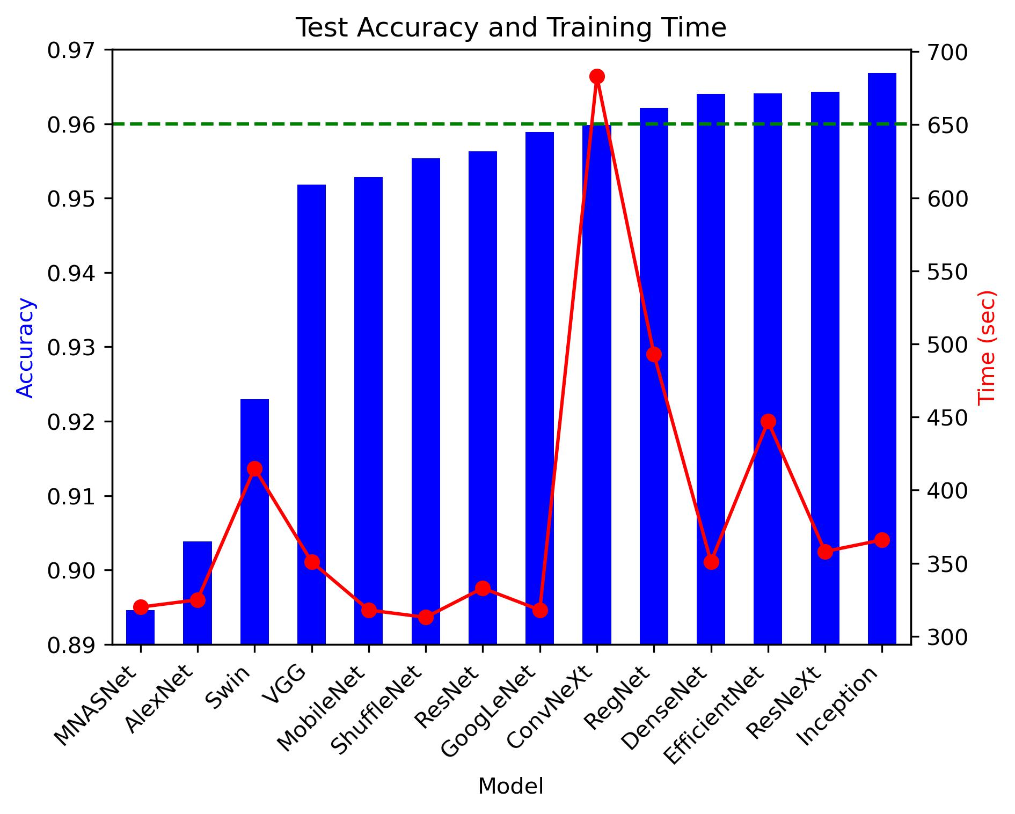
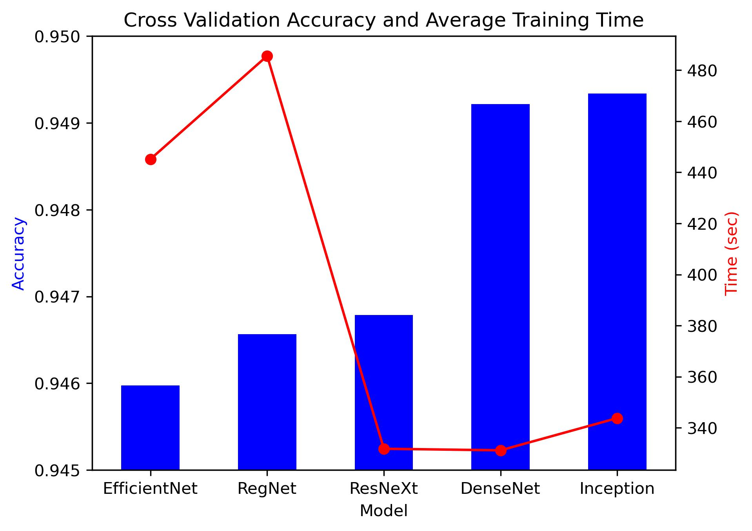
4.2. Vertebrae Detection: Backbone Model Selection
Single validation test (train-test ratio 8:2)
5-fold cross validation

Slide 31
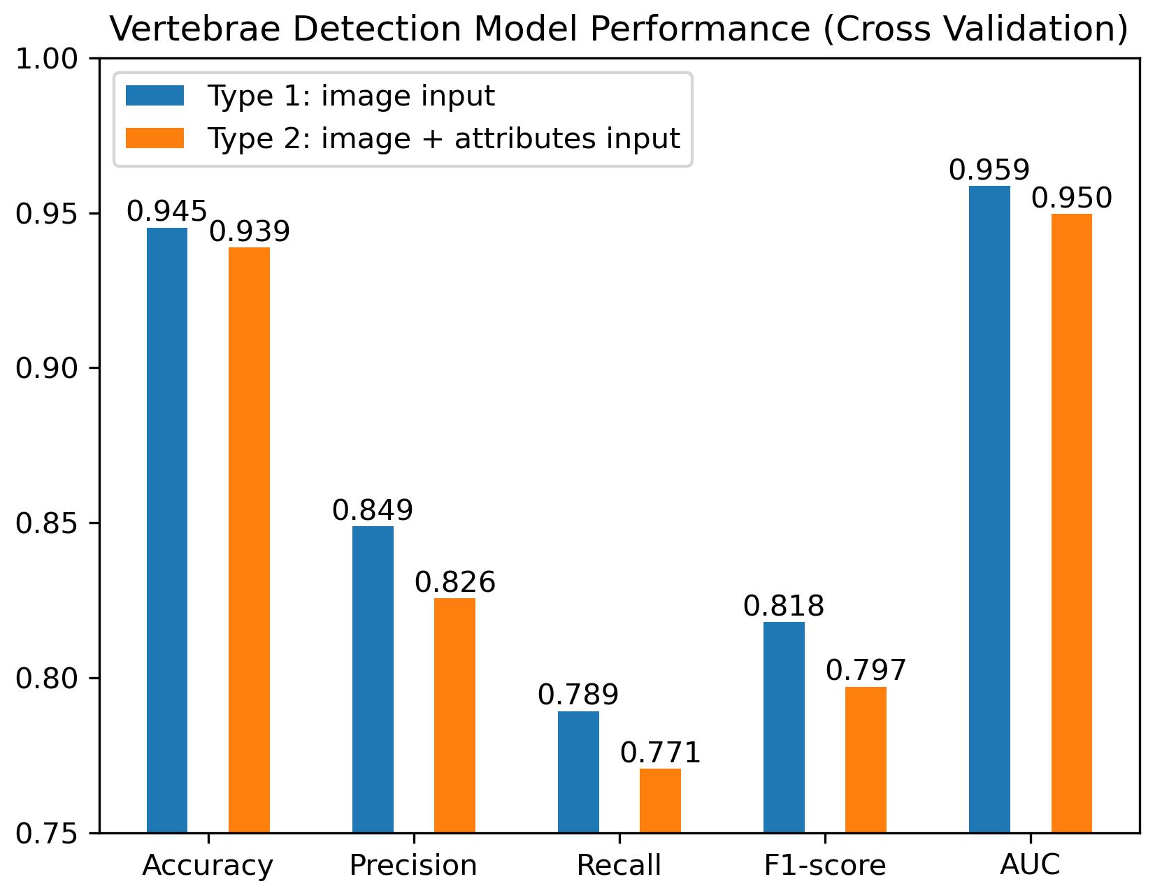
4.2. Vertebrae Detection: Type 1/2 Model Comparison
InceptionV3 backbone
5-fold cross validation
Performance: Type 1 > Type 2
Auxiliary attributes (slice ratio, image position, etc.) did not further bring useful information for vertebrae detection.

Slide 32
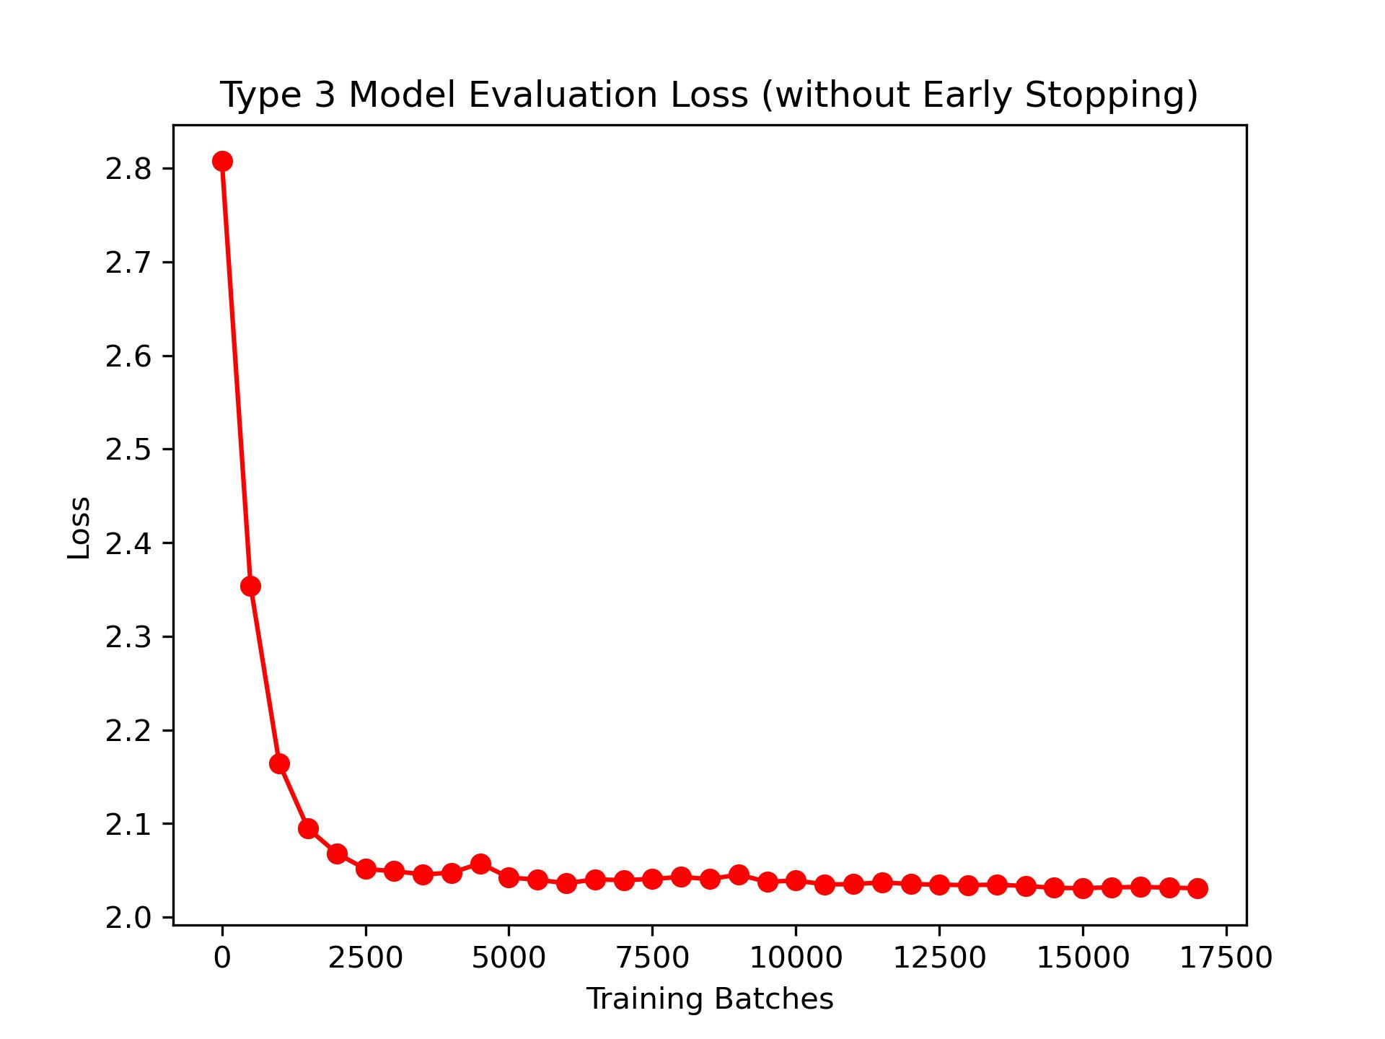
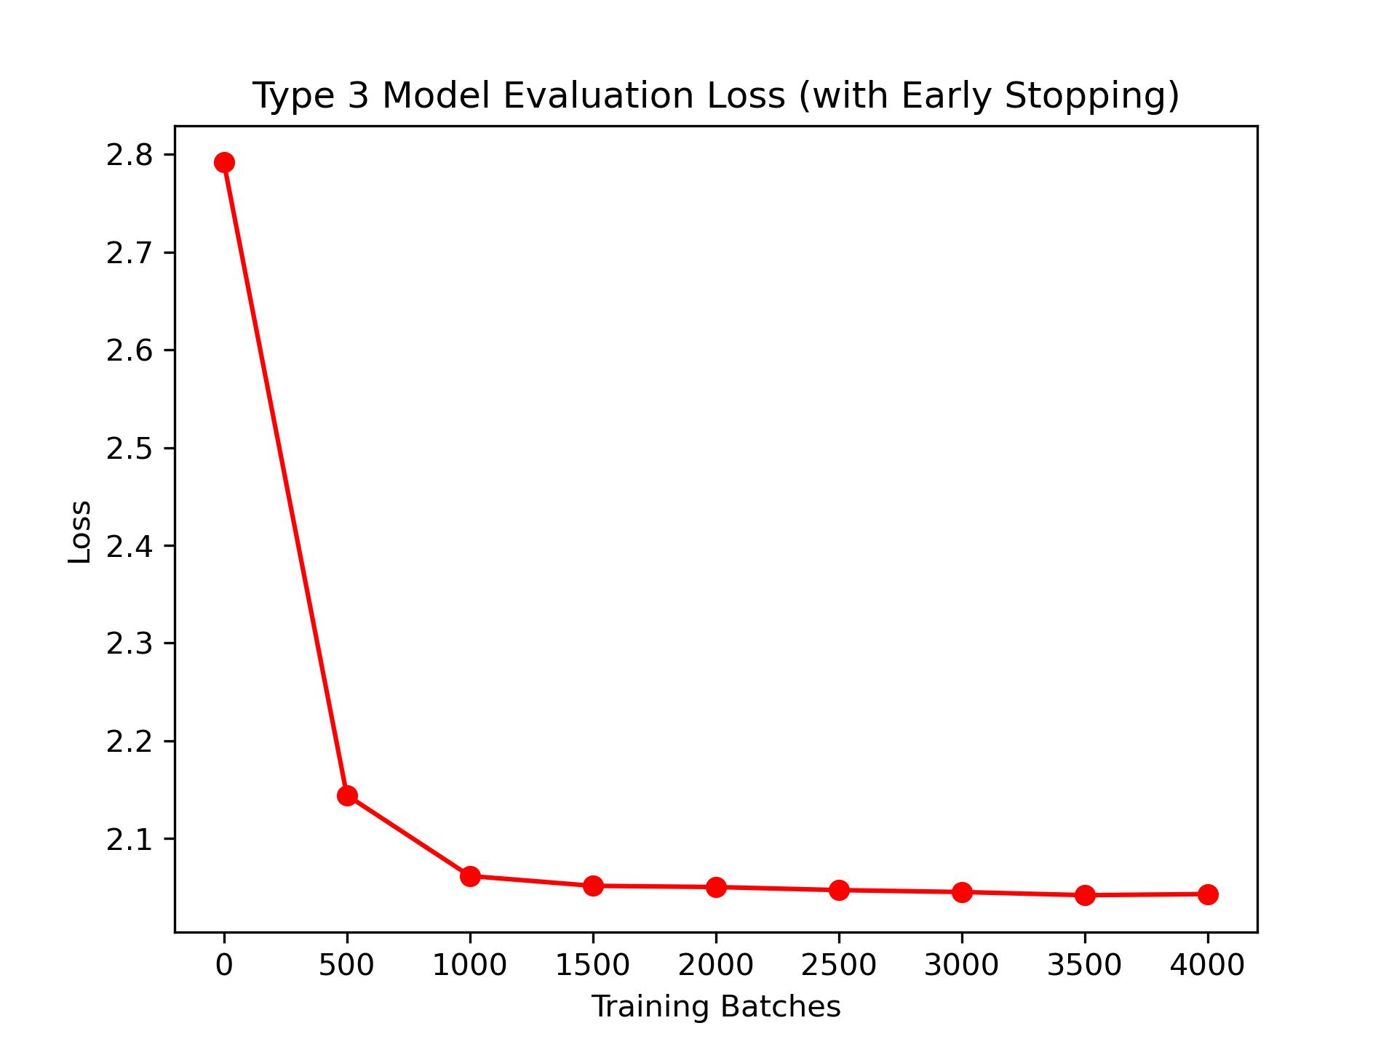
4.3. Fracture Detection: Evaluation Loss
Early Stopping
Early stopping demonstrated a positive effect on fracture detection model training.

Slide 33
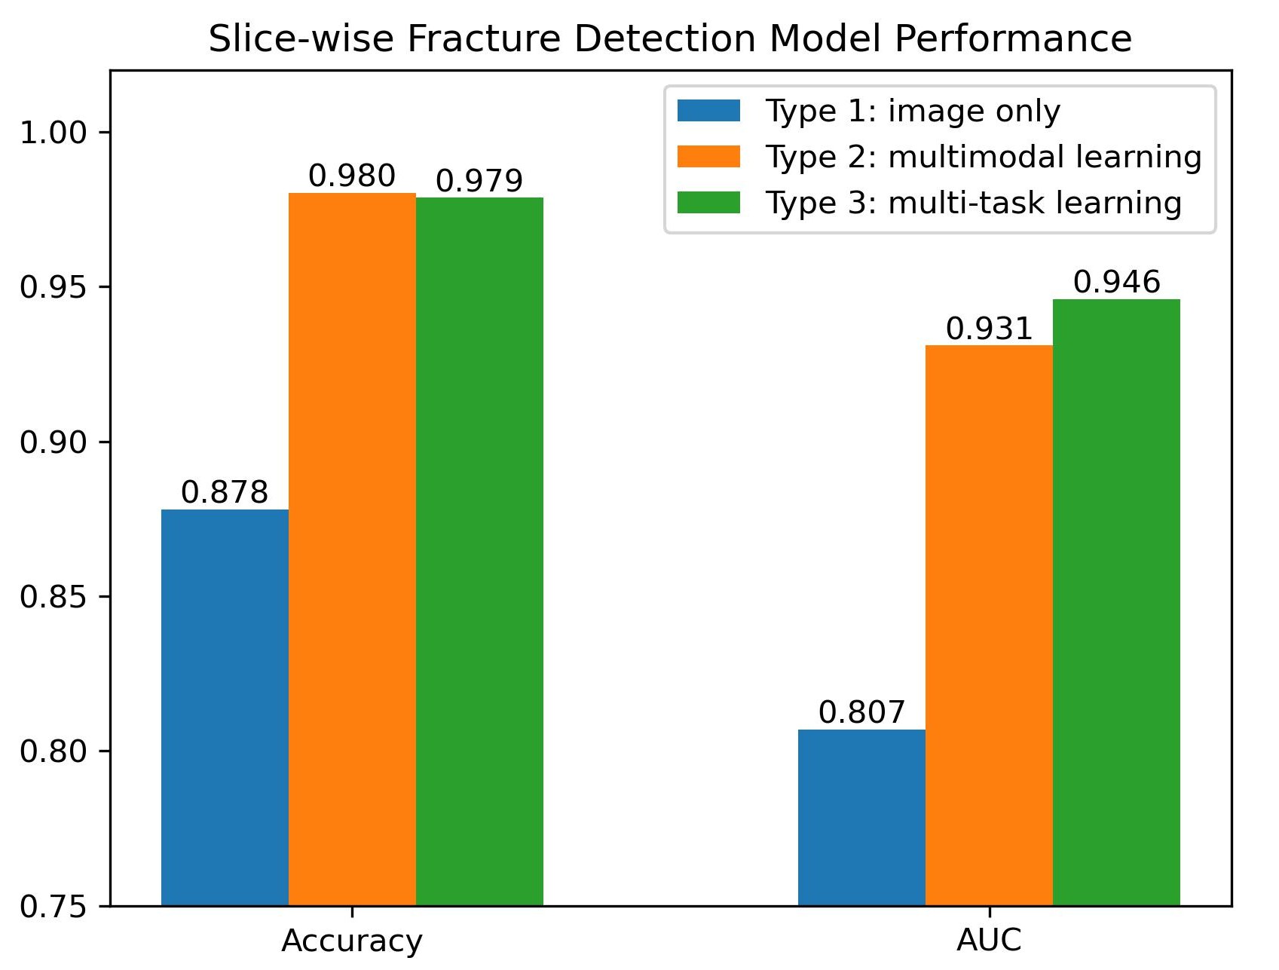
4.3. Fracture Detection (Slice-wise)
Performance:
Type 2 ≈ Type 3 >> Type 1
Type 2 & 3 models take multiple vertebrae into consideration for slice fracture detection.

Slide 34
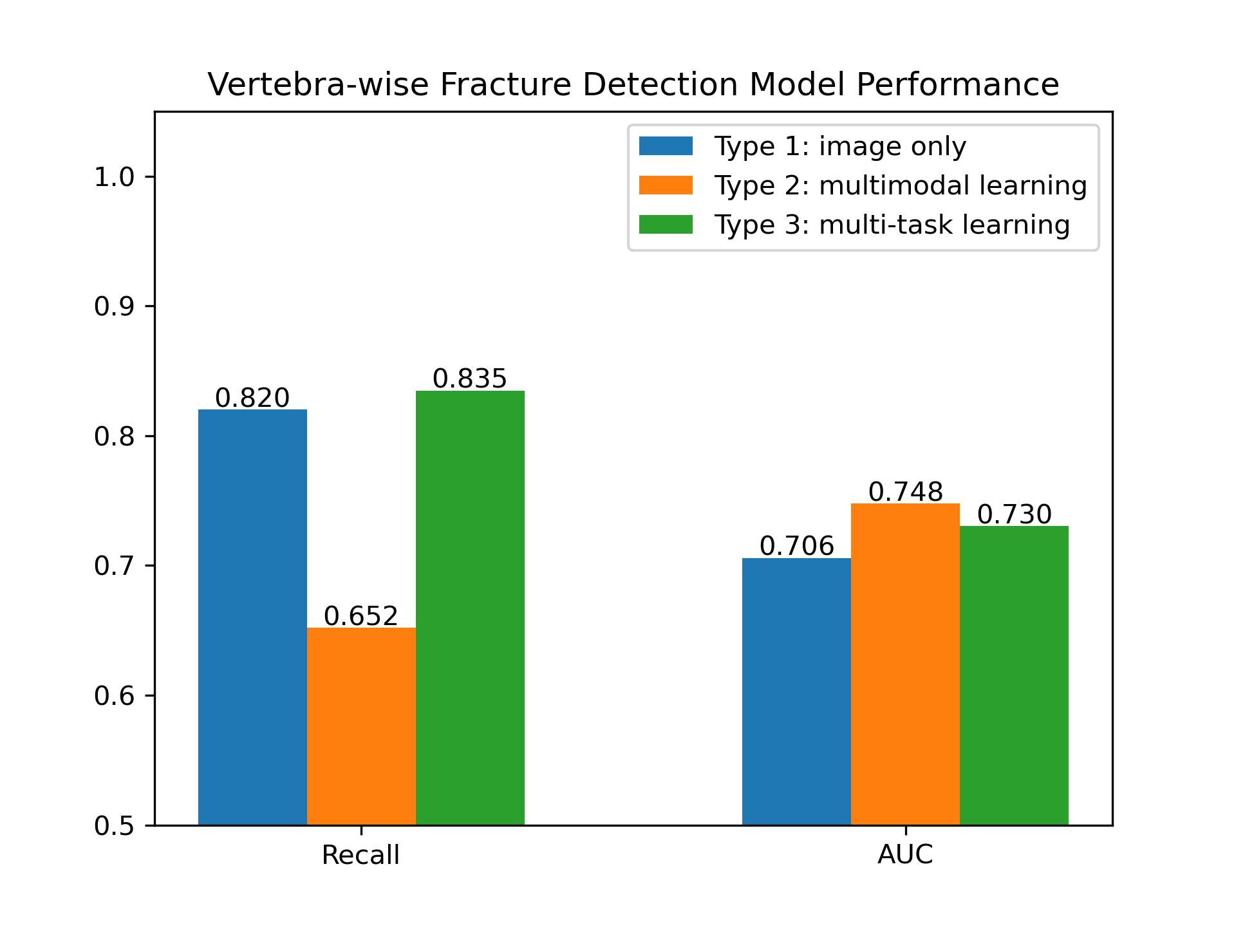
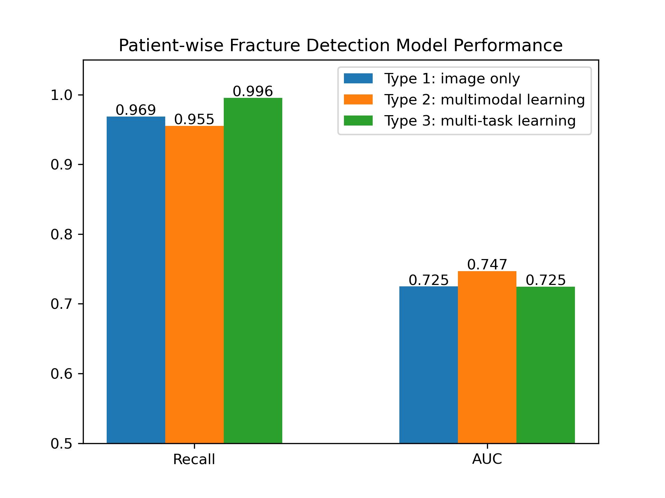
4.3. Fracture Detection (Vertebra/Patient-wise)
Decision threshold was determined by highest f1-score.
Models showed a lower recall for vertebra-level fracture detection.
99.6% patients with fracture can be successfully detected using Type 3 model.

Slide 35
4.4. Fracture Localization
Faster R-CNN with ResNet-50-FPN backbone
Weighted boxes fusion applied to merge multiple matches
Failed to locate fractures: validation IoU 0.100
Explanations:
No clear object boundary for a fracture
Arbitrarily determined bounding boxes
A better means with well-defined criterion to annotate fracture position is needed

Slide 36
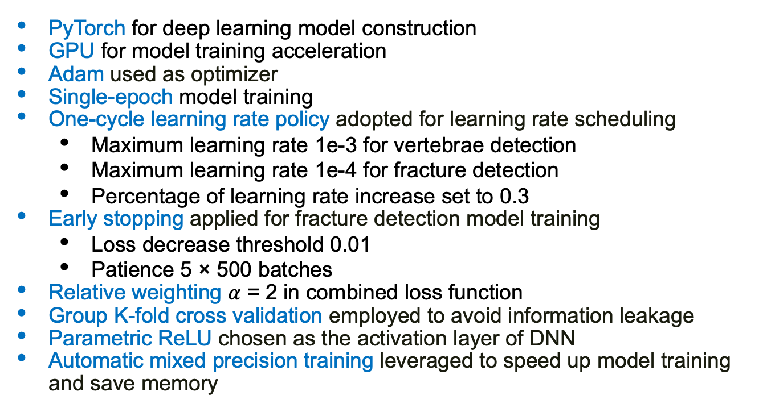
4.5. Implementation Details
PyTorch for deep learning model construction
GPU for model training acceleration
Adam used as optimizer
Single-epoch model training
One-cycle learning rate policy adopted for learning rate scheduling
Maximum learning rate 1e-3 for vertebrae detection
Maximum learning rate 1e-4 for fracture detection
Percentage of learning rate increase set to 0.3
Early stopping applied for fracture detection model training
Loss decrease threshold 0.01
Patience 5 × 500 batches
Relative weighting $α$ = 2 in combined loss function
Group K-fold cross validation employed to avoid information leakage
Parametric ReLU chosen as the activation layer of DNN
Automatic mixed precision training leveraged to speed up model training and save memory

Slide 37
5. Discussion

Slide 38
5.1. Difficulties and Limitations
Large-scale dataset (350 GiB):
Slow data preprocessing
Hyperparameter tuning too costly
Cannot train models for multiple epochs
Insufficient GPU memory:
Backbone models restricted to lightweight architectures
Limited batch size and slow training process
Inefficient to train a 3D CNN

Slide 39
5.2. Result Summary
Vertebrae detection:
accuracy 0.945, AUC 0.959
Fracture detection:
slice-level: accuracy 0.980, AUC 0.946
vertebra-level: recall 0.835, AUC 0.748
patient-level: recall 0.996, AUC 0.747
Fracture localization:
IoU 0.100 (failed)

Slide 40
5.3. Future Work
Image segmentation with advanced models
Multi-epoch model training for fracture detection
Hyperparameter tuning
Model architecture optimization
3D CNN for fracture detection
Fracture localization model design

Slide 41
6. Visualization

Slide 42
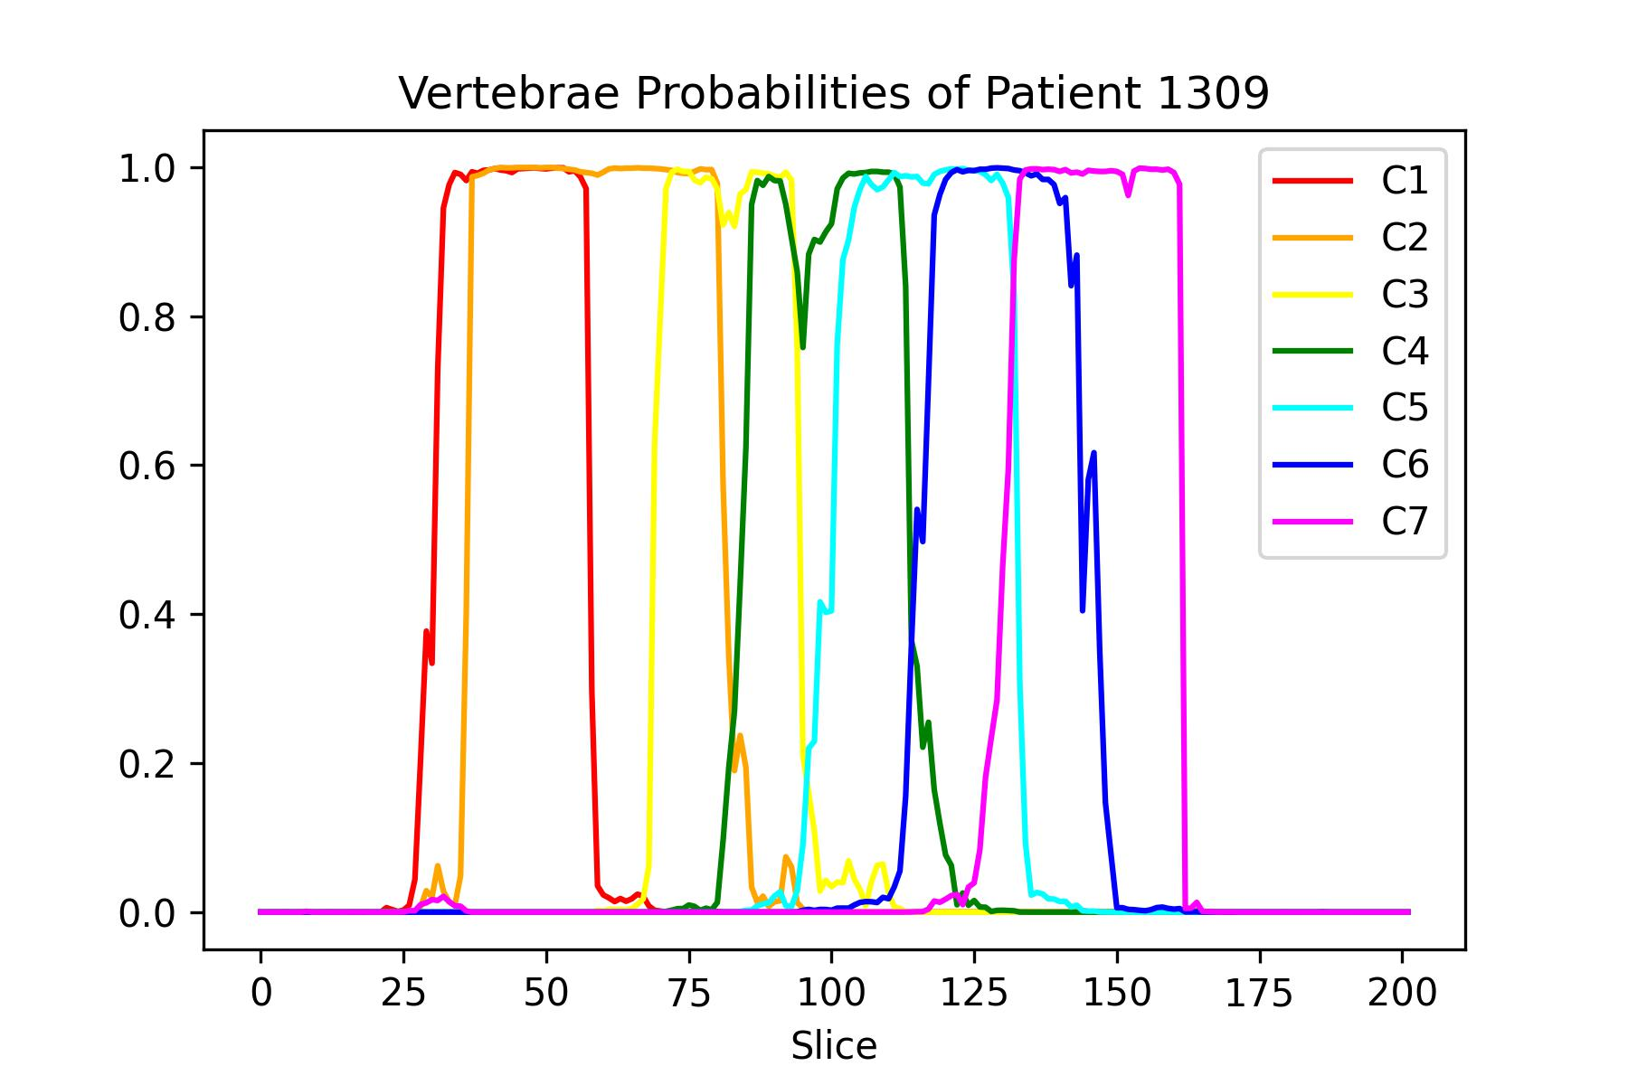
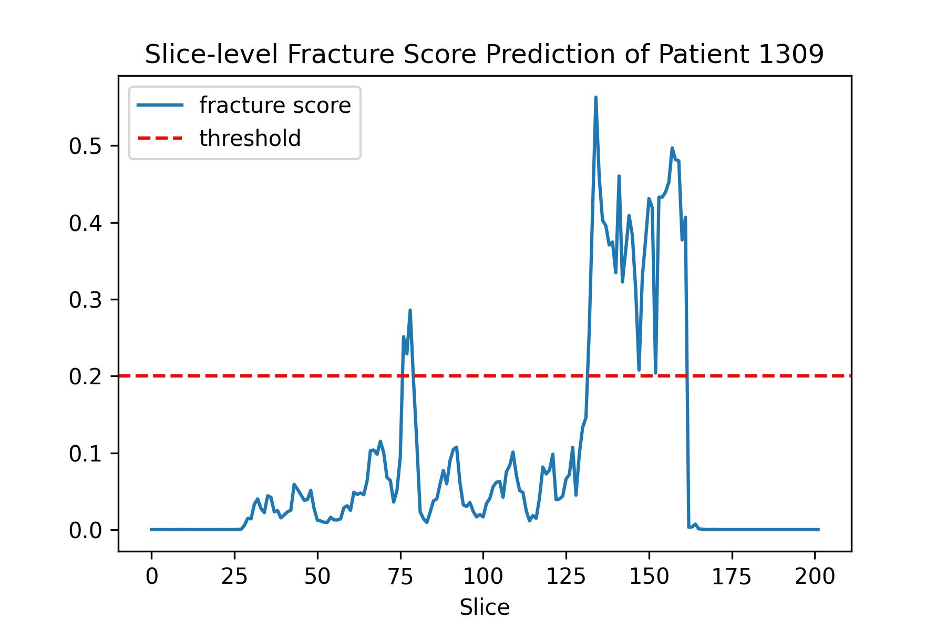
6. Visualization
Detection
Fracture approximately located at vertebrae C6 and C7

Slide 43
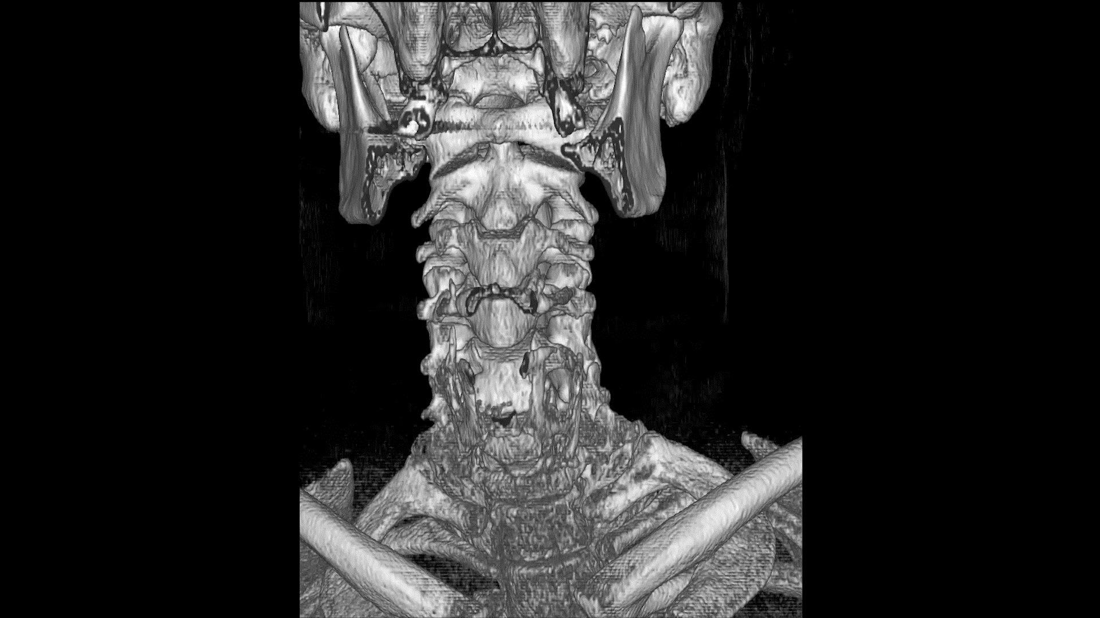
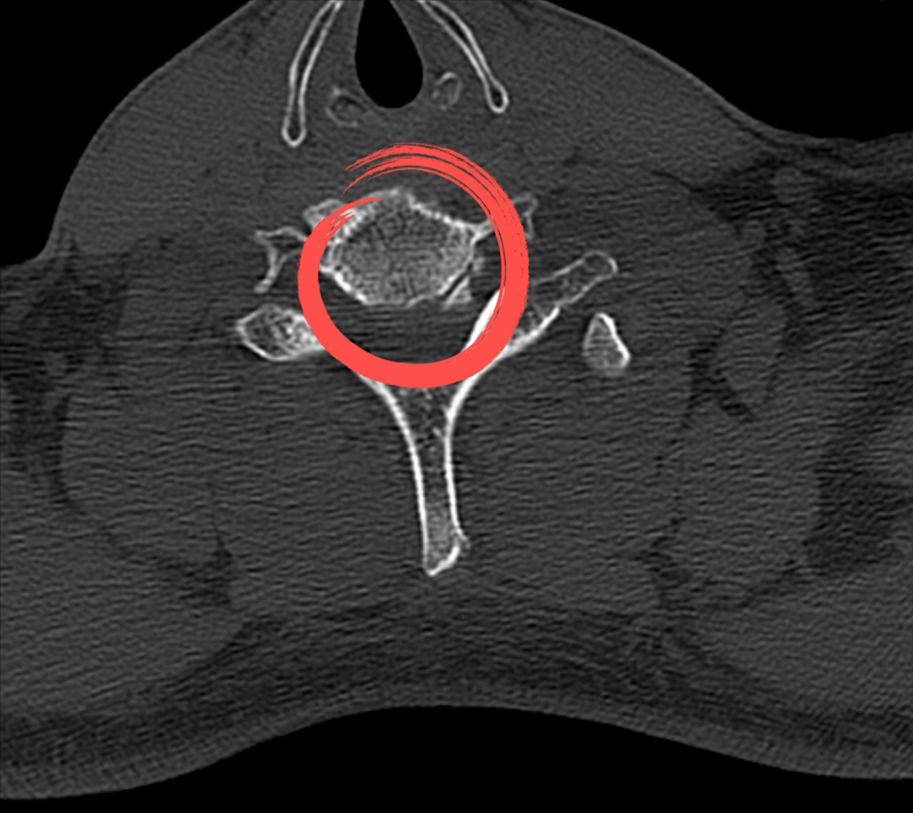
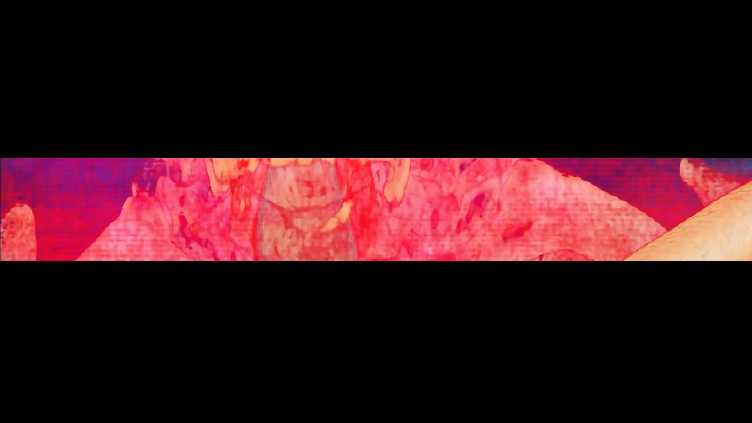
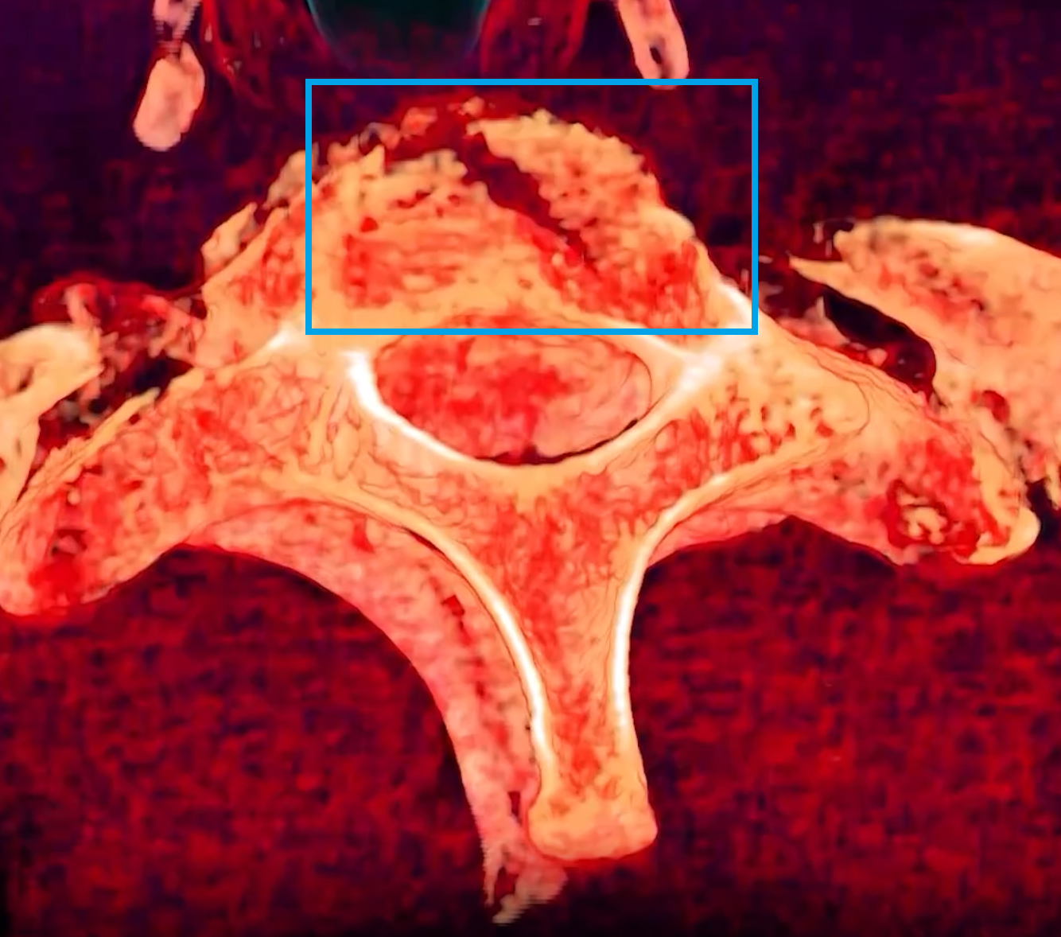

Slide 44
References

Slide 45
References
[1] D. Shen, G. Wu, and H.-I. Suk, “Deep learning in medical image analysis,” Annu. Rev. Biomed. Eng., vol. 19, no. 1, pp. 221–248, 2017.
[2] G. Litjens et al., “A survey on deep learning in medical image analysis,” Medical Image Analysis, vol. 42, pp. 60–88, 2017.
[3] J. Cho, K. Lee, E. Shin, G. Choy, and S. Do, “How much data is needed to train a medical image deep learning system to achieve necessary high accuracy?,” arXiv [cs.LG], 2015.
[4] Y. Li et al., “A comprehensive review for MRF and CRF approaches in pathology image analysis,” arXiv [cs.CV], 2020.
[5] A. N. Basavanhally et al., “Computerized image-based detection and grading of lymphocytic infiltration in HER2+ breast cancer histopathology,” IEEE Trans. Biomed. Eng., vol. 57, no. 3, pp. 642–653, 2010.
[6] J. Bioucas-Dias, F. Condessa, and J. Kovacevic, Alternating direction optimization for image segmentation using hidden Markov measure field models In: Gurcan MN, Madabhushi A, editors. IS&T/SPIE electronic imaging. International Society for Optics and Photonics. 2014.
[7] A. Van Engelen Κ.Ά, “Three-dimensional carotid ultrasound plaque texture predicts vascular events,” Stroke, vol. 45, no. 9, pp. 2695–2701, 2014.
[8] H. C. Achterberg et al., “Hippocampal shape is predictive for the development of dementia in a normal, elderly population: Hippocampal Shape is Predictive for Dementia,” Hum. Brain Mapp., vol. 35, no. 5, pp. 2359–2371, 2014.
[9] M. de Bruijne, “Machine learning approaches in medical image analysis: From detection to diagnosis,” Med. Image Anal., vol. 33, pp. 94–97, 2016.
[10] J. Zhuang, J. Cai, R. Wang, J. Zhang, and W.-S. Zheng, “Deep kNN for Medical Image Classification,” in Medical Image Computing and Computer Assisted Intervention – MICCAI 2020, Cham: Springer International Publishing, 2020, pp. 127–136.

Slide 46
References
[11] A. Krizhevsky, I. Sutskever, and G. E. Hinton, “ImageNet classification with deep convolutional neural networks,” Commun. ACM, vol. 60, no. 6, pp. 84–90, 2017.
[12] K. Simonyan and A. Zisserman, “Very deep convolutional networks for large-scale image recognition,” arXiv [cs.CV], 2014.
[13] K. He, X. Zhang, S. Ren, and J. Sun, “Deep residual learning for image recognition,” arXiv [cs.CV], 2015.
[14] M. Tan and Q. V. Le, “EfficientNet: Rethinking model scaling for convolutional Neural Networks,” arXiv [cs.LG], 2019.
[15] S. Ruder, “An overview of gradient descent optimization algorithms,” arXiv [cs.LG], 2016.
[16] D. P. Kingma and J. Ba, “Adam: A method for stochastic optimization,” arXiv [cs.LG], 2014.
[17] F. Zhuang et al., “A comprehensive survey on transfer learning,” arXiv [cs.LG], 2019.
[18] T. Baltrušaitis, C. Ahuja, and L.-P. Morency, “Multimodal machine learning: A survey and
taxonomy,” arXiv [cs.LG], 2017.
[19] S. Ruder, “An overview of multi-task learning in deep neural networks,” arXiv [cs.LG], 2017.
[20] L. N. Smith and N. Topin, “Super-convergence: Very fast training of neural networks using large
learning rates,” arXiv [cs.LG], 2017.
[21] “RSNA 2022 cervical spine fracture detection,” Kaggle.com. [Online]. Available: https://www.kaggle.com/competitions/rsna-2022-cervical-spine-fracture-detection/data. [Accessed: 03-Dec-2022].
[22] P. Micikevicius et al., “Mixed Precision Training,” arXiv [cs.AI], 2017.
[23] R. Solovyev, W. Wang, and T. Gabruseva, “Weighted boxes fusion: Ensembling boxes from different object detection models,” Image Vis. Comput., vol. 107, no. 104117, p. 104117, 2021.

Slide 47
Q & A

Slide 48
thank you

